Slide 1
Fundamentals of Programming
Session 4

Slide 2
Agenda
Review Last Session – Chapter 2
  Variables, Simple I/O
Lecture/Discuss Chapter 3
  Control Structures
Programming Segment:
  Grade Assignment #3
  Work on Assignment #4

Slide 3
Introduction to Computer Programming
Chapter 3: Control Structures

Slide 4
Control Structures
Control structures are industry conventions used to create pieces to “snap together”
They are the building blocks of true structured programming
Knowing the basic control structures will enable you to program logic in any programming language
  (once you learn the syntax)

Slide 5
Contents
Using if, if-else, if-elif-else Structures
Using while Loops

Slide 6
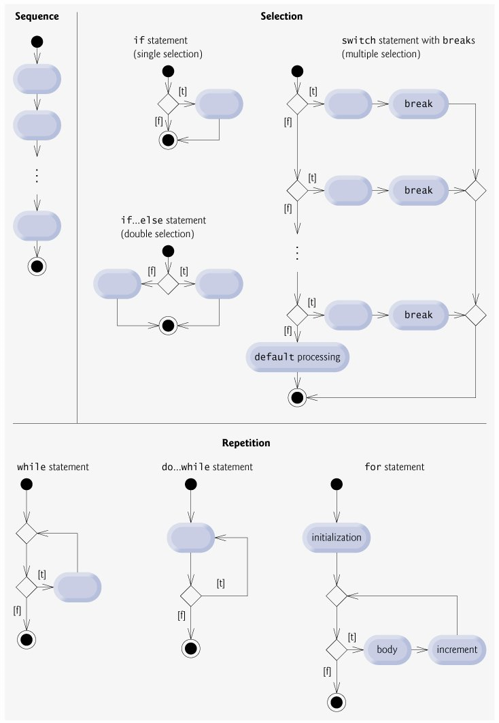
Decision or Selection Structures

Slide 7
Using the if Structure
Branching is how computers and computer programs make decisions
  Make a decision to take one path or another
The if structure allows your program to branch to a section of code…or skip it

Slide 8
Using the if Structure
All if structures (statements) have a “condition” that evaluates to either “True” or “False”
if password == “secret”:
  print “You’re In!”
Notice the colon(:) at the end of the line and that the next line is indented
Notice the double equal (==)

Slide 9
Comparison Operators
== equal to
!= not equal to
> greater than
< less than
>= greater than or equal to
<= less than or equal to

Slide 10
Indentation Blocks
Code statement blocks in if structures (any control structure) need to be indented
  Python automatically tabs after (: enter)
  tabbed or spaced inside
  improves readability
  determines what is the “True” block from other code

Slide 11
Using the if-else Structure
Sometimes programs need to make a choice
  if the condition is “True” execute something
  if the condition is “False” execute something else
  if password == “secret”:
    do something (true block)
  else:
    do something else (false block)
Example: Granted or Denied

Slide 12
Using the if-elif-else Structure (nested if’s)
If the program needs to choose from more than two possibilities
if x == 1:
  y = y+1
else:
if x== 2:
y = y+2
else:
if x == 3:
  y = y+3
else:
  y = y-10

Slide 13
Using the if-elif-else Structure
(CASE Structure)
If the program needs to choose from more than two possibilities…use the if-elif-else structure
if x == 1:
  y = y+1
elif x == 2:
  y = y+2
elif x == 3:
  y = y+3
else:
  y = y-10

Slide 14
Using the if-elif-else Structure
Important!
  Once a condition evaluates to true in an
  if-elif-else structure, the computer executes the corresponding block.
  The other conditions are not evaluated

Slide 15
Loops/Iteration
Looping is used to repeat a set of instructions one or more times
Either until a certain condition is true
Or, until the set of instructions have been executed a specified number of times
Using loops in your programs save time, money and computer resources

Slide 16
Repetition (Loop) Structures

Slide 17
Creating while Loops
Repetition is another control structure
  Also known as looping
While hair is not clean:
  Rinse, Lather, Repeat
Need to make sure we can control and stop the looping structure

Slide 18
Loops/Iteration (with a counter)
Most Loops have 4 basic steps:
Initialize the loop counter
Check for loop completion
Perform the set of instructions
Increment/decrement the loop counter
Some loops however may not use loop counters, but depend on a condition only

Slide 19
Creating while Loops
Python WHILE loop is an example of a “sentry controlled loop”
  Also known as a “pre-test” loop
Example: Three Year Old Simulator

Slide 20
Avoiding Infinite Loops
An infinite loop is a loop whose exit condition remains true never terminates
Example:
    counter = 0
    while counter <= 10:
      print counter
Often infinite loops are a form of logic error
  but not always!

Slide 21
Treating Values and Conditions
All expressions have a conditional value
  That is all expressions (numeric, string, boolean, etc) will evaluate to either True or False
Basic rule is this…
  False is anything “empty” or “zero”
  True is anything else (“non-empty” or “not zero”)

Slide 22
Treating Values as Conditions
A=0
if A then: (this would evaluate FALSE)
B=“Steve”
if B then: (this would evaluate TRUE)
Other Examples
  0 is False
  “” is False
  2500 is True
  “Hello Class” is True

Slide 23
Boolean Switch
blnProcess=True #set switch on
while blnProcess:
……loop process
…..to end loop
blnProcess=False #turn switch off

Slide 24
Creating Intentional Infinite Loops
break – breaks out of a loop
  Terminates the loop prior to the exit condition becoming false
continue – jump back to the top of the loop

Slide 25
Using Compound Conditions
So far, conditional expressions are considered to be simple
  Only one conditional operator is used
Often programs must check more than one conditional expression to make decisions or to control loops

Slide 26
Using Compound Conditions
Use and, or, and not to form
compound conditions

Slide 27
Using Compound Conditions
NOT
A | Not A
False | True
True | False
AND
OR
A | B | A AND B
False | False | False
False | True | False
True | False | False
True | True | True
A | B | A OR B
False | False | False
False | True | True
True | False | True
True | True | True

Slide 28
Compound Conditions
If strName == “steve” and strPW == “secret”:
print “Login successful!”
while strName != “steve” or strPW != “secret”:
strName = input(“Enter your loginID: “)
strPW = input(“Enter your password: “)

Slide 29
Assignments
Read Chapter 4
  For Loops, Strings, and Tuples
Programming Segment:
  Grade Assignment #3
  Work on Assignment #4

